Slide 1
Advancing air safety in the North
Northern Air Transportation Association
Ian MacKay
Member, Transportation Safety Board
8 April 2013

Slide 2
Outline
Organizing for safety: governance and oversight
TSB Watchlist 2012
  CFIT and SMS
Safety culture
Lightweight flight recording devices
Conclusion

Slide 3
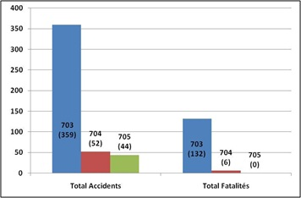
Statistically significant
91 percent of commercial aircraft accidents 702/703/704
93 percent of commercial fatalities 702/703/704

Slide 4
Organizing for safety
Governance
Safety Culture
Safety Management System
Standard Operating Procedures
Operations
O
V
E
R
S
I
G
H
T

Slide 5
The role of governance in safety management
Board of Directors / Owner
Is a safety governance framework in place?
Is there a board committee charged with safety governance?
Safety qualifications
Is senior management held to account for safety?
Shareholders / Investors / Financial Backers
Is safety considered part of investment decision?
Is the board/owner held to account for safety?
Senior Management
Safety qualifications
Safety reporting to board/owner
Are risks including safety risks being properly managed?
Allocation of resources
Priority setting

Slide 6
The role of oversight in safety management
Customers
Do customers consider safety in choosing aviation suppliers?
Do customers monitor safety of suppliers on an ongoing basis? Is it effective?
To what extent do insurers influence safety action?
Accident Investigations
Do organizations learn from accident investigations reports?
What drives an organization to make safety changes as a result of an accident?
Insurers
Do insurers consider safety in the decision to insure?

Slide 7
The role of oversight in safety management (cont’d)
Safety Regulators
Do we have realistic expectations on the extent to which regulators can influence day-to-day safety?
What kind of regulatory oversight is required?

Slide 8
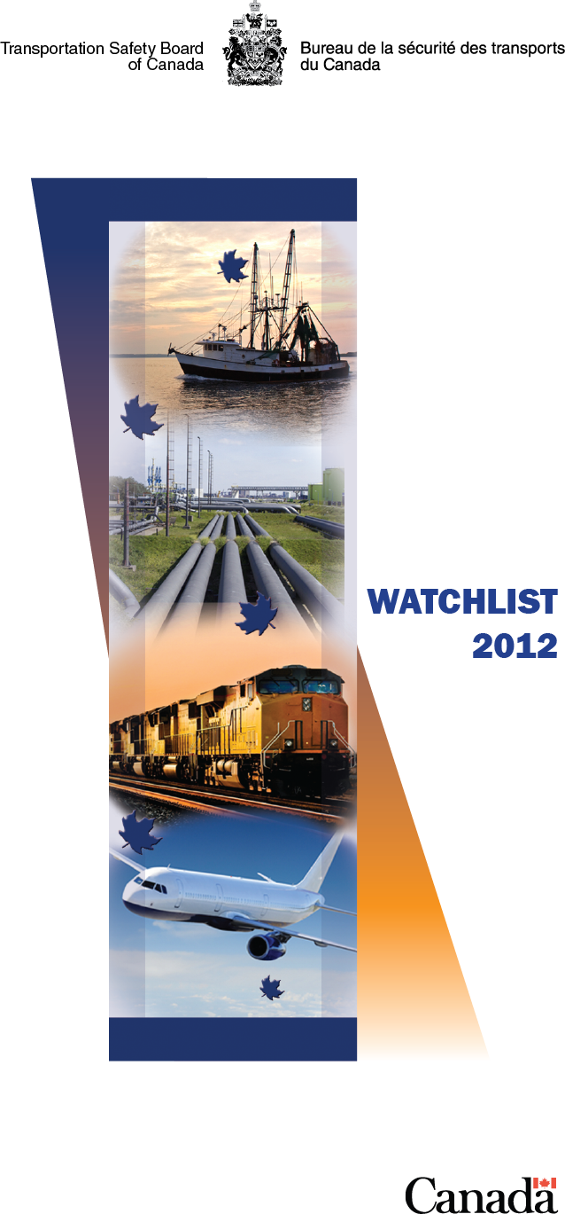
TSB Watchlist
Marine
  Safety management systems
  Loss of life on fishing vessels
Air
  Collisions with land and water
  Safety management systems
  Landing accidents and runway overruns
  Risk of collisions on runways
Rail
  On-board video and voice recorders
  Following signal indications
  Passenger trains colliding with vehicles

Slide 9
TSB Recommendation A12-02
“The Department of Transport require
the use of the stabilized constant descent angle
approach technique in the conduct of
non-precision approaches
by Canadian operators.”
— TSB Investigation Report A09Q0203 (Exact Air)

Slide 10
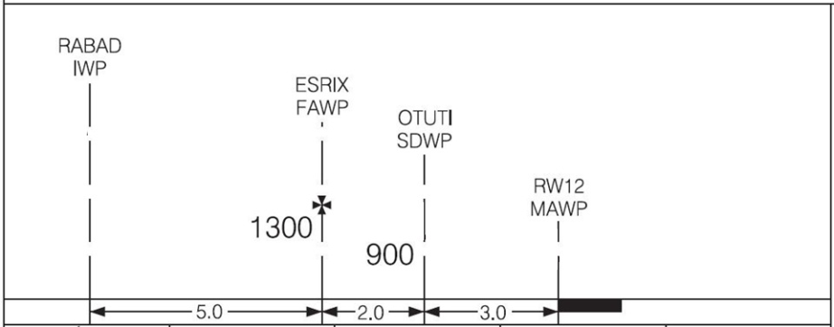
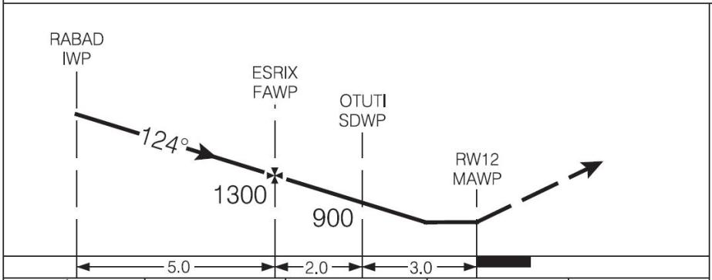
A12-02 (cont’d)
SCDA
Step Down Descent
Blue line: step-down technique
Green line: stabilized constant descent angle (SCDA) technique
Blue line: step-down technique
Green line: stabilized constant descent angle (SCDA) technique

Slide 11
SMS in recent investigations
  Hazard identified, report made, mitigation planned … but second company aircraft has accident before mitigation is in effect (TBA)
  Hazard of pre-existing condition not recognized as worthy of SMS analysis (Sunwing A11O0031)
  Employees not given clear guidance on what is reportable/Local SOPs established without safety risk assessment (Kelowna Flightcraft A11A0035)

Slide 12
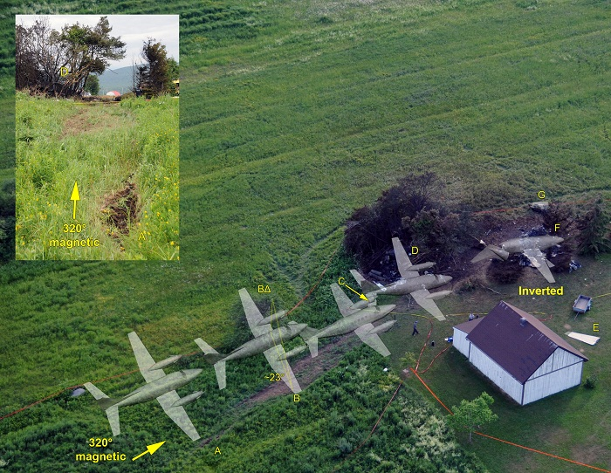
Safety culture and SMS
TSB Investigation Report A10Q0098 (Aéropro)

Slide 13
Causes and contributing factors (Aéropro)
The poor safety culture at Aéropro contributed to the acceptance of unsafe practices.
The significant measures taken by TC did not have the expected results to ensure compliance with the regulations, and consequently unsafe practices persisted.
      Question: Can SMS work in an operation with a poor safety culture?

Slide 14
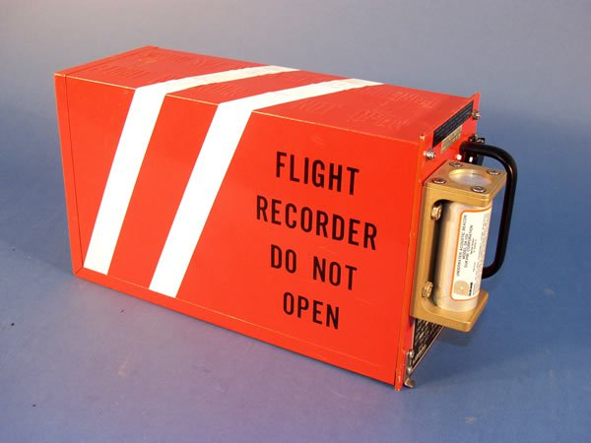
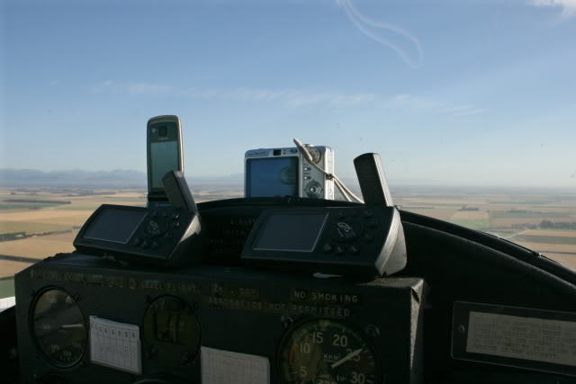
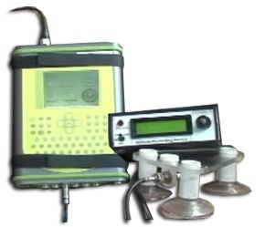
Lightweight flight recording systems

Slide 15
“I’m legal, but am I safe?”
“The gap between what is legal and what
is safe already is large, and it will get
bigger. … Is this regulatory approach
sustainable? Is it fair to airlines that do
everything right? Is it fair to an
unknowing public?”
-William Voss, formerly of Flight Safety Foundation

Slide 16
QUESTIONS?

